Slide 1
Indie DevOps and Analytics Building big games with tiny teams. John Bergman Founder, CEO – Guild Software

Slide 2
Who Am I?
Used to build Big ISP Networks, Services.
Started Guild Software circa 1998.
Personally implemented most of the services I’m discussing today.

Slide 3

Who are We?
Vendetta Online ships weekly updates across 5 major platforms.
Yearly game-available target of 99.95%
MMORPG has been online since 2002.
Proprietary 3D and client/server engine.
Four-person dev team.

Slide 4
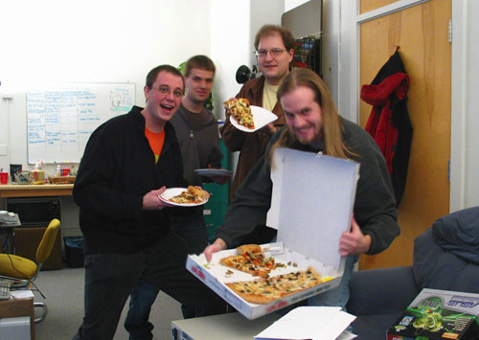
So, you have a tiny Dev Team?

Slide 5


Cost vs Time

Slide 6

Types of Costs: Up-front vs Recurring
Up-front sucks immediately.
Recurring sucks.. FOREVER.

Slide 7
Minimizing both Time and Cost
If someone else will reliably manage the problem for free.. Let them!
(But be aware of any long-term tradeoffs).
Reduces recurring maintenance time, security headaches, etc.

Slide 8
Free, Low-Cost Service Examples:
Company Email - Gmail
Bulk Email - Amazon SES, Sendy, Mandrill
Monitoring/Webhooks - UptimeRobot, StatusCake
Client Metrics - Flurry, Google Analytics, etc.
Server Metrics - New Relic, NodeQuery, etc.
DNS (hosting) - CloudFlare, Hurricane Electric
DNS (GeoIP) - Rage4, NSOne, etc.
CDN - CloudFlare, KeyCDN, MaxCDN

Slide 9

Minimizing Cost
When outsourcing is too costly, DIY starts to look a lot better.
But, always be aware of the recurring maintenance time-vs-cost tradeoff.

Slide 10
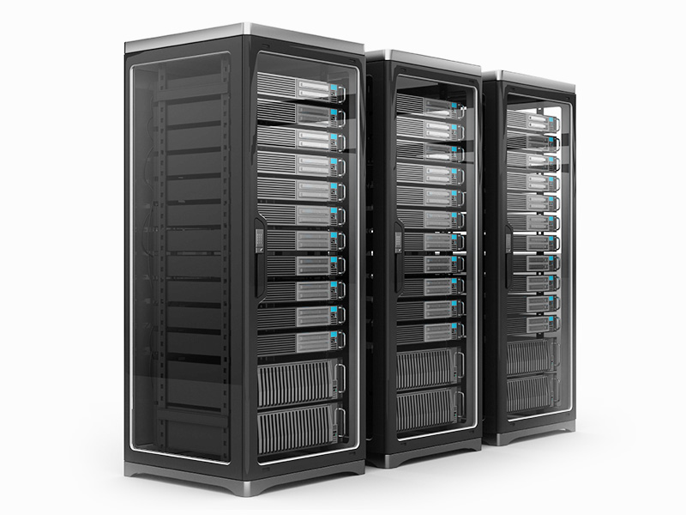
Server Infrastructure

Slide 11

Indie Server Scale Challenges
Many F2P games require huge player bases to be financially successful.
Huge player bases are a scalability problem.
“Feature” transient loads can be large: 1 million new users per week.

Slide 12
Rules of Reduced Server Costs:
Minimize your per-node footprint (RAM, Disk, CPU cores).
Building fault-tolerance into your app architecture allows cheaper infrastructure.
Faster server code means more capacity per node.

Slide 13
Have an Optimization Plan
Plan for compiled libs, JITs, something..?
Keep in mind, C++ is ~600x faster than Ruby.
See “Computer Language Benchmarks Game”
Capacity test for rough ideas of scalability.

Slide 14
Other Server Tradeoffs
32bit vs 64bit OS with VO: 40% ram savings, 10% CPU hit.
FYI: Garbage Collecting VMs can blow up on long runtimes.

Slide 15
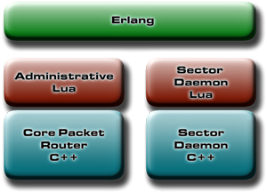
Architecture Matters!
Heavy lifting, rapid allocations in C++
Lighter “Gameplay” in Lua, or Erlang.
Erlang is hosted separately.

Slide 16

The Cloud

Slide 17

Cloud Competition is Intense

Slide 18

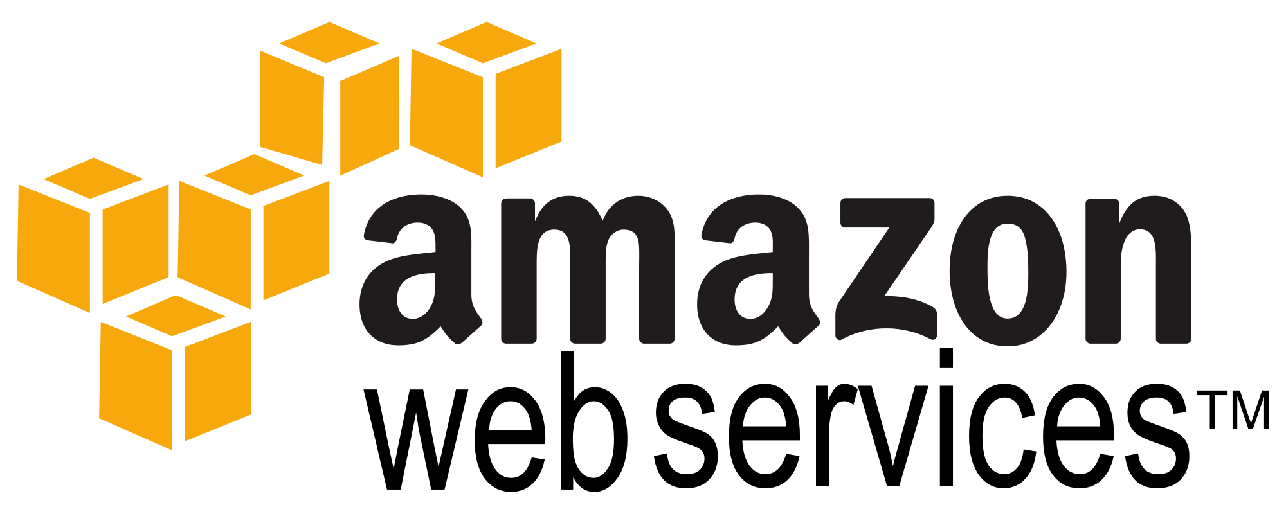

Type I - Largest Infrastructure

Slide 19





Type II – Enterprise Focus

Slide 20






Type III – Public and Dev focus

Slide 21



Type IV – Mystery VPS Providers (Riskier, but can sometimes be decent).

Slide 22
TANSTAAFL
Type I has great features. Amazon DynamoDB, Route53, ElastiCache, etc.
Type II has more Managed options for services.
Type III is inexpensive, but more DIY oriented.

Slide 23
DigitalOcean vs Amazon
Amazon bandwidth costs 4X more.
DO disk IO is ~4X faster (average).
Amazon CPU/IO may be more consistent.
DigitalOcean CPUs are just as fast in small instances as in large ones.

Slide 24
Ten Node Cost Comparison: 40 CPUs, ~80GB of ram, 800GB SSD, 10TB xfer
Amazon, c4.xlarge
OnDemand: $1500/mo
EBS 800GB SSD: $80/mo
10TB $0.09/GB: $921/mo
Total: $2501/mo
DigitalOcean, 8GB/4cpu
OnDemand: $800/mo
SSD Disk: included
5TB included, +$102*
*(DO doesn’t actually charge)
Total: $902/mo
*($800 current actual)

Slide 25
Virtualization Tradeoffs
Xen may exhibit timing instability (PLL).
OpenVZ is Linux-only, “burstable ram” options, no kernel tweaks. Ram-efficient.
VMWare has cool features, but can’t monitor Steal Time.
KVM allows kernel tweaking, zRam, etc.

Slide 26
Providers by Hypervisor Type
Xen - AWS, Linode, RackSpace, SoftLayer
KVM - Google Compute, DO, Vultr, Altantic.net, RamNode
Hyper-V - Azure, SoftLayer
VMWare - ServerCentral, SoftLayer, Aruba
OpenVZ - RamNode

Slide 27
Monitoring “Steal” Time
“Steal” CPU time on KVM, OVZ, Xen: neighbors causing processes to wait.
Netflix 2011: Dump the node and re-create.

Slide 28
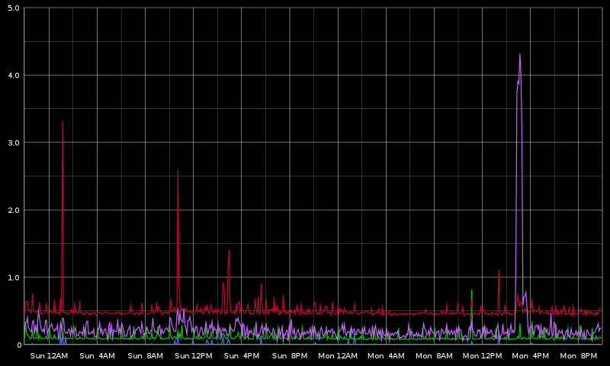
Small 4% CPU spike in Steal

Slide 29
Monitoring “IOwait” Time
IOwait (all hypervisors): degree to which processes are stalled on disk IO.
May trigger from bad neigbors, backups, hypervisor bugs.

Slide 30
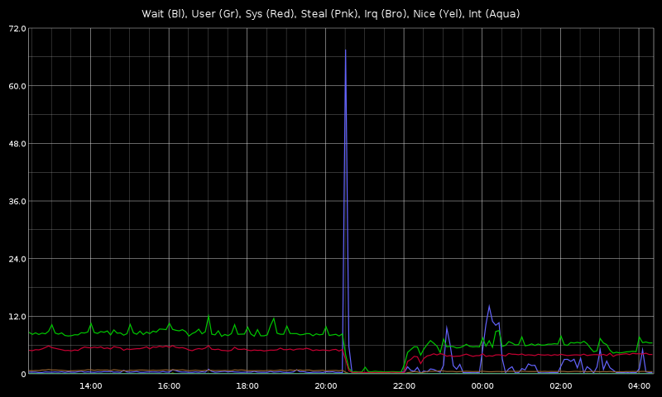
IOwait Example
Cross-cluster IO stall.
Stalled game for 1.5 minutes.
Resulted in game outage.
Drove peak load to ~5.5.

Slide 31
IOwait: Async Logging
Don’t do classic “printf to file” logging in the cloud.
IO-stalls will block your entire process.
Instead, use syslog, or other async option.

Slide 32

Don’t be a dick
Target less than 50% CPU usage per node.
Some providers will knock you off for over-use of CPU, I/O.

Slide 33

The Cloud Is Finite

Slide 34
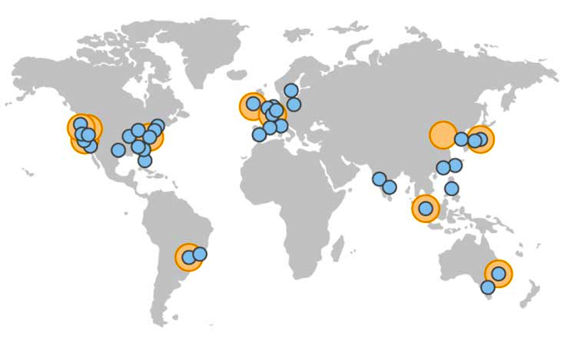
Cloudburst Capacity: What other providers are nearby?

Slide 35



Multiple Providers? Choose a Widely Available OS variant.

Slide 36
Low-Cost Dedicated Hardware
Kimsufi (OVH) – Xeon 8c, 16GB ECC, 100Mbp unmetered: $28/month.
Scaleway – ARM 4c, 2GB ram, 50GB SSD, 200Mbp unmetered: €2.99/month.
(100Mbp = ~32TB/month)
32TB/month is $2785 from Amazon
But.. limited location options, etc.

Slide 37
Colocation can be Cheaper
A full cabinet in the US is ~$1500/mo.
Unmetered bandwidth by the gigabit is ~$1/meg ($0.003/GB/mo. US, major network point).
Cheap off-lease cloud servers on Ebay.
Hardware can be a big hassle. But possible option at scale.

Slide 38

Case Study: Vendetta Online Patch Distribution.

Slide 39
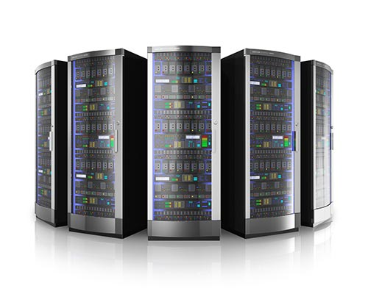
Proprietary Delta-Patch Server Network
Server cluster must be:
Globally Distributed
Good local-region bandwidth (tiny patches per user, but fast downloads, many users).
Resilient to outages (network/nodes/service).
Inexpensive!

Slide 40
Geo-Distribution Options
Anycast: the “Right Way”, but requires a big network and AS for BGP route advertisements. Used internally by Google, etc.
Amazon Route53 LBR allocates by relative latency to an AWS DC.
GeoIP: the “Cheap Way”, works well with caveats. Used by Wikipedia, Akamai, many others.

Slide 41
VO “PatchStorm” Cluster
Network of virtual nodes in US, Europe, Asia.
GeoIP through Anycast DNS provider (Rage4).
Client-side failover to backup cluster in ~5 seconds.
Server status monitored by UptimeRobot
Server-side down-node removal within ~600 seconds.

Slide 42
Resulting Performance
Excellent localized proprietary TCP service in many regions (easily expanded).
Many GB per day pushed at locally-fast speeds, minimal cost.
Only took a few days to initially set up.
Very fault tolerant: Node stability less critical.

Slide 43
Resulting Network
UptimeRobot monitoring: Free!
Number of Servers: 12
Included Monthly Bandwidth: ~15TB
Separate Domain: $15/year
Rage4 usage: ~$2/month
Total Cost: ~$18/month
Rough AWS Equiv: ~$250 to $1300/month

Slide 44
“Gotcha” notes
Weird routing: Miami may be faster to Brazil than.. Brazil.
Different VPS providers have various bandwidth overage policies. Read fine print.
Large public DNS providers (Google, 8.8.8.8) may share cache across regions, breaking GeoIP for those users. In practice: not a significant issue.
Professional CDN is probably easier/better for pure downloads, but not proprietary service.

Slide 45
Other Options
Host GeoDNS yourself: PowerDNS, GeoIP back-end, rsync free MaxMind database weekly (what Wikipedia does).
But, recurring time-cost not worth it.

Slide 46
Alternative Services
The same fundamental architecture could probably serve many asynchronous games with GeoIP locality/performance.

Slide 47
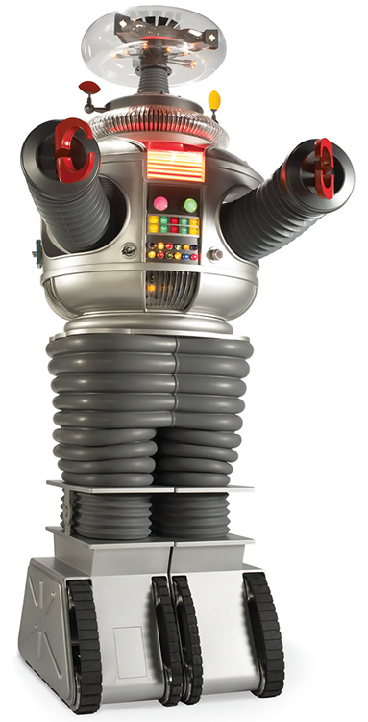
Server Automation

Slide 48

Thou Shalt
Automate Everything
Monitor, Measure and Record Everything
Alarm Everything

Slide 49
Automation..
Is critical for small teams.
Reduces administrative errors.
Is necessary to let you scale quickly and elastically.

Slide 50
Which Automation?
Salt vs Ansible vs Puppet vs Chef
Google uses Puppet, Yahoo uses Chef
Puppet and Chef have more setup complexity to help large environments.
Salt and Ansible are both simple and lightweight.

Slide 51
Ansible and Salt
Ansible only requires SSH access (cool).
Salt is another connection, but very fast.
Salt-ssh replicates ssh-only automation.
Upshot: Preferred the activity of the Salt community, and usage of Python.
Use what you like?

Slide 52
Salt-Cloud
Cross-API elastic node management in the cloud.
Inherently speaks to AWS, RackSpace, DigitalOcean, Linode, others.
Not hard to configure for other APIs.
Not as full-featured as individual provider tools, but cross-platform.

Slide 53
Easy to add
Salt only took a couple of days to learn.
Fast to integrate new nodes.
Secure: key-auth, AES on transport.
Mixed with other tools (rsync), super helpful.
Easy to script, program, etc.

Slide 54
Implementation Notes
Differentiate and group server/node naming conventions by maintenance usage.
Could be by service-type, or geography (DC), whatever is likely to be referenced.
Shell-style globbing is used. ‘host*’ or
‘host[1-5]’ or ‘host[1,5]’, etc.
We firewall the salt master. YMMV.

Slide 55
Obvious Example is Obvious
Update an ipv4 firewall across all “core” servers:
salt-cp ‘core*' rules.v4 /etc/iptables
salt ‘core*' cmd.run 'iptables-restore < /etc/iptables/rules.v4'

Slide 56
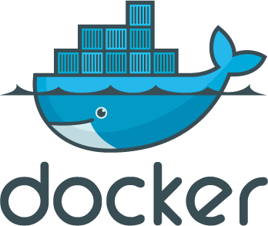
Automation, Releasing and Reverting

Slide 57
Docker: Dependency Sanity
Package up your entire server app, binaries, and all dependencies into a single image.
Distribute and run that package anywhere, identically, without virtualization overhead.
Roll an updated image for each release.
Revert with absolute certainty.
Very elastically friendly. Easy to spin up dev nodes.

Slide 58
Docker: Caveats
Image size may directly impact distribution time and elastic startup delay.
A repository can be run locally in a DC
Or I/O intensive data could be acquired via other channels.
64bit Only at present.

Slide 59
Docker: Try services easily
There is an existing Docker image for a great many services. Ready to roll.
Don’t want to configure Graphite, Apache, Statsd, Grafana, to all play together..?
Install a Docker image in one command.

Slide 60
Automated Client Testing
Very helpful, but not a panacea.
Open-source frameworks: Appium, Calabash, etc.
Cloud-based devices: TestDroid, Xamarin, AWS Device Farm, $0.17/min.

Slide 61

Monitoring, Analytics

Slide 62
Monitoring, Stress-Testing
Build a headless test-client!
Use meaningful player behaviour to test/alarm “server-online” status.
Re-use the same test-client to implement a server stress-test, prior to launch.

Slide 63
Automated Bug Reporting
We have crash reporting and a backtrace system on both the clients and server.
Makes reaction to bugs much faster, more accurate.
Simplest client-side implementation:
Write out critical data on crash.
On startup, detect the file very early.
Submit via HTTPS on next runtime.

Slide 64
Metrics & Analytics
Absolutely critical! No excuse to not have something.
If you have ZERO time/budget, then:
Implement Flurry on the client-side.
New Relic for server monitoring.
Completely free, to any scale, with good basic data.

Slide 65
Out-Sourced Analytics: Benefits
Many options: Localytics, Mixpanel, New Relic, etc.
Near-zero upfront cost (time or money), should “just work”.
Lots of intelligent defaults for common cases.
“Free” usage tiers of meaningful scale.

Slide 66
Out-Sourced Analytics: Flipside
Configured for common-case, not “You”.
Varying degrees of flexibility.
Anything custom can be expensive.
Data resolution can be poor (or expensive).
High usage loads can become costly.
Third-party SDK/library may break your app.

Slide 67
For Example..
Metrics via Mixpanel: 20 million data points per month, $2000/month.
Vendetta Online server cloud: 260 million data points per month. Cost: a few days of setup, 42kbits of bandwidth, 350MB of disk space.
BUT, not a 1:1 comparison!

Slide 68
Graphite is Awesome!
Zero setup time for new metrics.
Graphing detached from storage (Carbon).
Many third-party front-ends.
Easy to tie in log aggregation, data-mining.
Monitoring/Alarms on time/series data changes.
Lots of integrated math functions, etc.

Slide 69
Carbon stores Data
"Whisper" time/series database.
Fixed size, determined by aggregation type.
Aggregation chosen by regex match, on metric initialization.
Data precision can be as high as per-second, useful for server profiling.
Average/Sum/Last/Min/Max options for aggregation.

Slide 70
Creating a Metric is Trivial
Any metric can be generated by sending this, to a carbon server:
<metric path> <metric value> <metric timestamp>

Slide 71
Server Storage Aggregation
Server data: A reasonable picture of recent activity, 46kB of disk per metric. BUT, there may be many metrics. Roughly 320 per server, or ~15MB:
[servers]
pattern = ^servers.*
retentions = 60s:4h,5m:2d,30m:1w,2h:30d,4h:90d,1d:5y

Slide 72
Revenue Storage Aggregation
Revenue data, summed and not averaged, kept at higher accuracy. 112kB per metric:
[revenue]
pattern = ^revenue.*
retentions = 5m:14d,30m:4w,2h:90d,4h:180d,1d:5y

Slide 73
Doing this:
echo "servers.vo-sc.`hostname`.sd.totalmemory" `ps -axm | grep "\.\/bin\/sd" | sed "1 d" | awk '{print $9 * 1024}' | paste -sd+ - | bc` `date +%s` | nc -q5 redacted.hostname.com 2003;

Slide 74
Sends this output:
servers.vo-sc.voc11.sd.totalmemory 111009792 1445666511

Slide 75
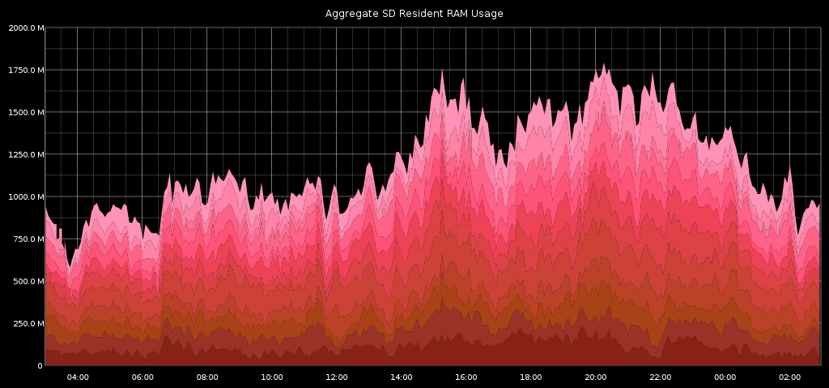
And results in:

Slide 76
Graphite Renders Carbon data
Can be hosted separately from Carbon.
Default front-end, graphing, dashboard.
Stores graph-config data in sqlite (read-side scale issue for some).
Far better third-party options, Grafana uses d3.js and lets you zoom/scale data in realtime.

Slide 77
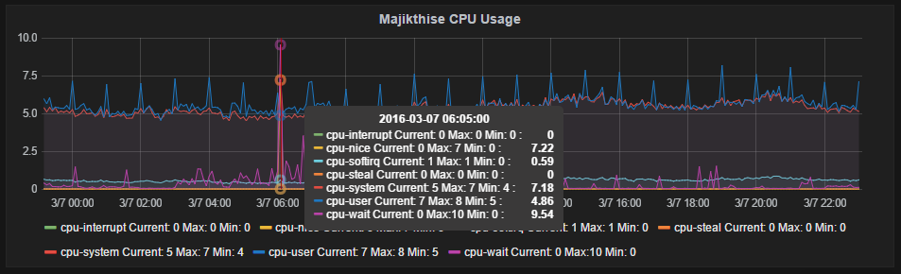
Grafana Example Data is easily zoomed, scaled, measured.

Slide 78
Combine Metrics Arbitrarily
Cross-combine and mix any metric, or metrics, with any others.
For instance, even simple dashboards..

Slide 79
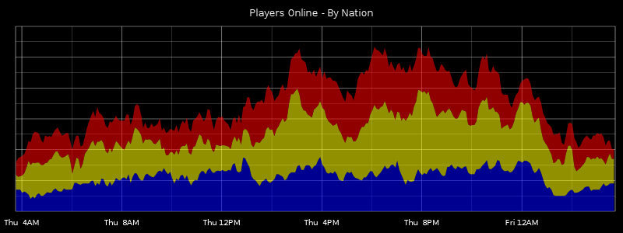
Active Players – By Faction

Slide 80
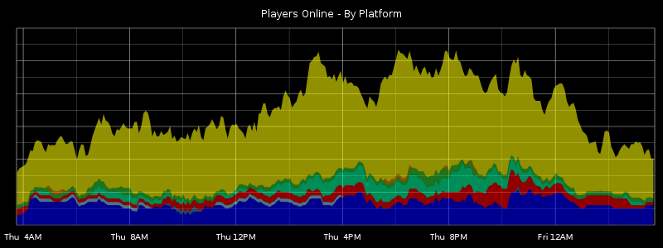
Active Players – By Platform

Slide 81
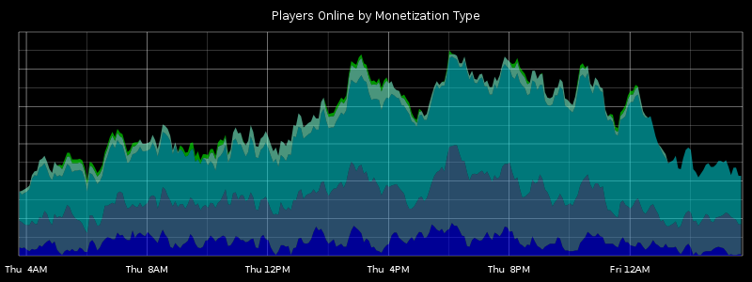
Active Players – By Monetization

Slide 82

Aggregating Cluster Data
Rapidly get a picture of combined “server weather” status.

Slide 83
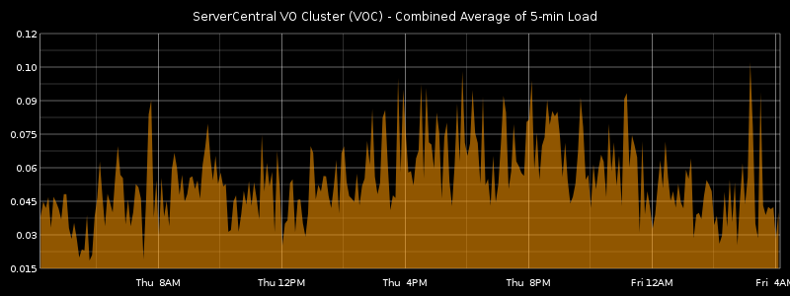
5-min Load, Averaged per DC

Slide 84
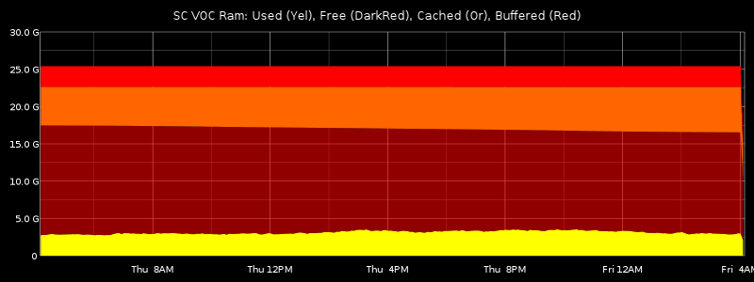
Summed Ram usage across a DC

Slide 85
Correlate Disconnected Data
Blend data from related, but disconnected inputs to gain insights.
Separate Y-axes (left vs right) allow unique scales.

Slide 86
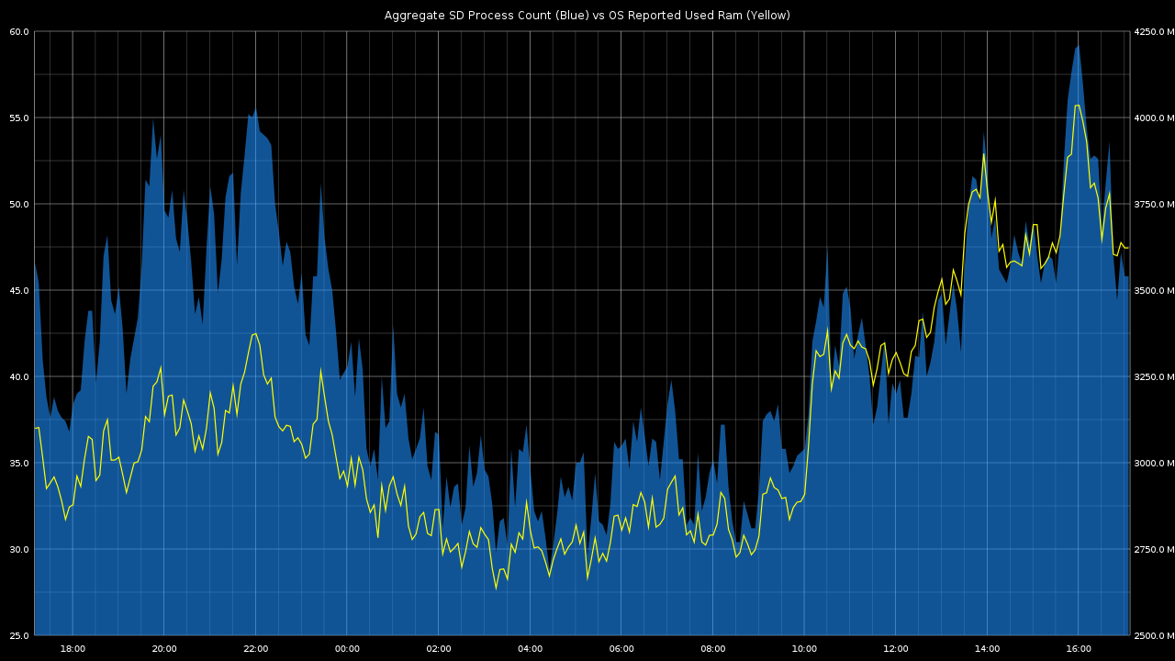
Process Count vs RAM footprint

Slide 87
Easily profile rapid changes.
Server was exhibiting sporadic disk IO latency spikes.
A simple script, with “ioping” greatly helped analysis.

Slide 88
Simple Script, results in..
#!/bin/sh
while [ 1 ]
do
date=`date +%s`
echo "pulse.office.`hostname`.ioping.10second.max" `ioping -c 1 -q -p 1 . | \
awk '{ print $2 }'` "$date" | nc -q 600 redacted.hostname.com 2003 &
sleep 10
done

Slide 89
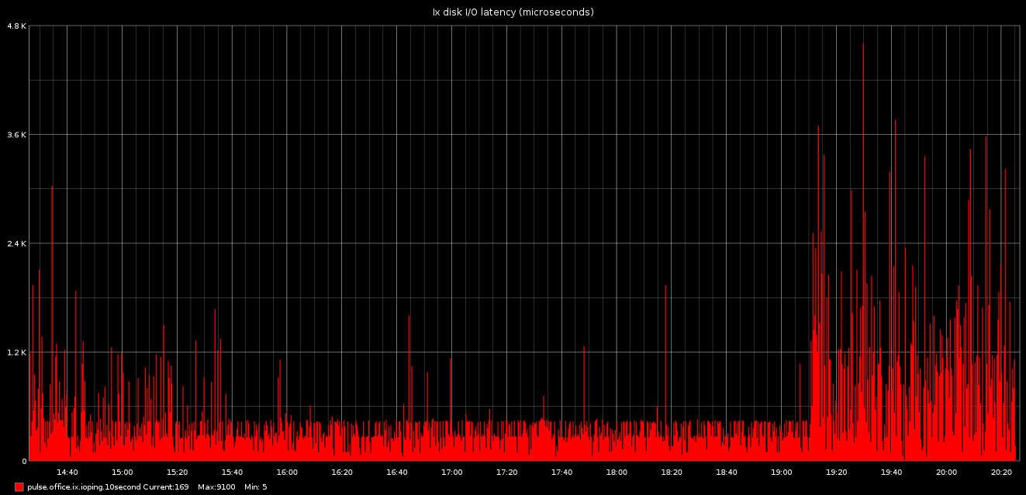

Slide 90
Elastic? Construct on the fly.
All graphs are simple URLs with parameters (or csv/json/etc).
Trivial to add and remove elastic nodes.
Graph by percentage-of-total instead of summed aggregate, etc.

Slide 91
Combined Game Metrics
We record a lot of metrics per player.
Thus, we can later combine them to get..
Monetization of AppleTV vs AndroidTV vs Xbox users.
Percentage of VR players who use gamepad vs mouse/keyboard.
PvP success of mobile vs PC players.
Whatever else we can imagine, and record.

Slide 92
DrawAsInfinite
Allows a vertical line to be set at a specific time.
Helps correlate non-numerical events. Ie:
See spike in item sales vs an item stat change.
Players online with start/end value of a major guild event.
Instances of opened support tickets vs recorded latency.

Slide 93
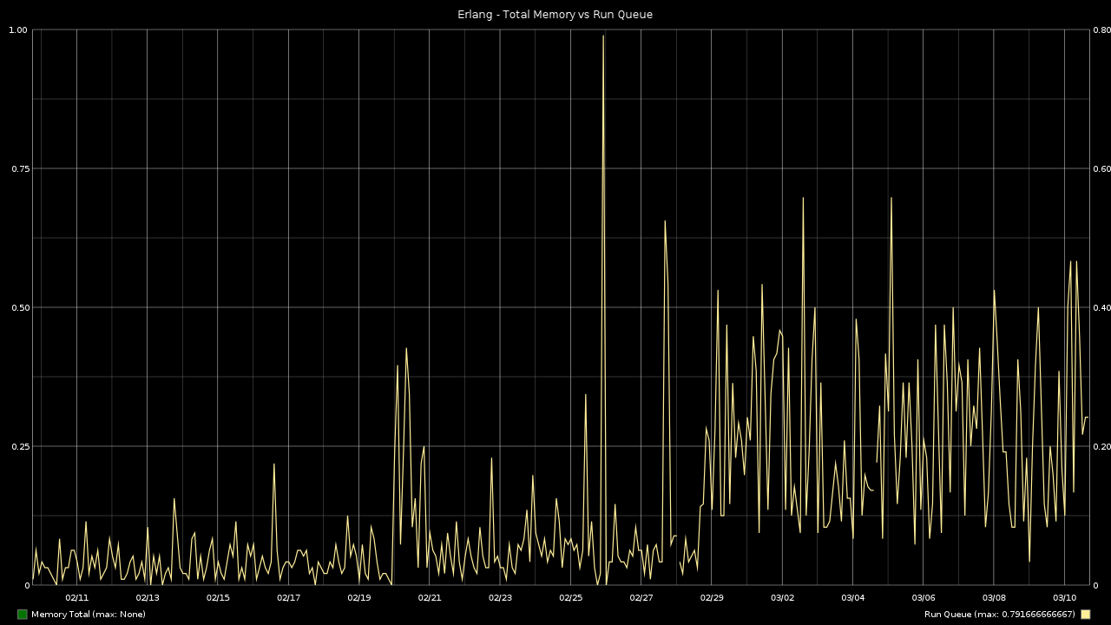

Slide 94
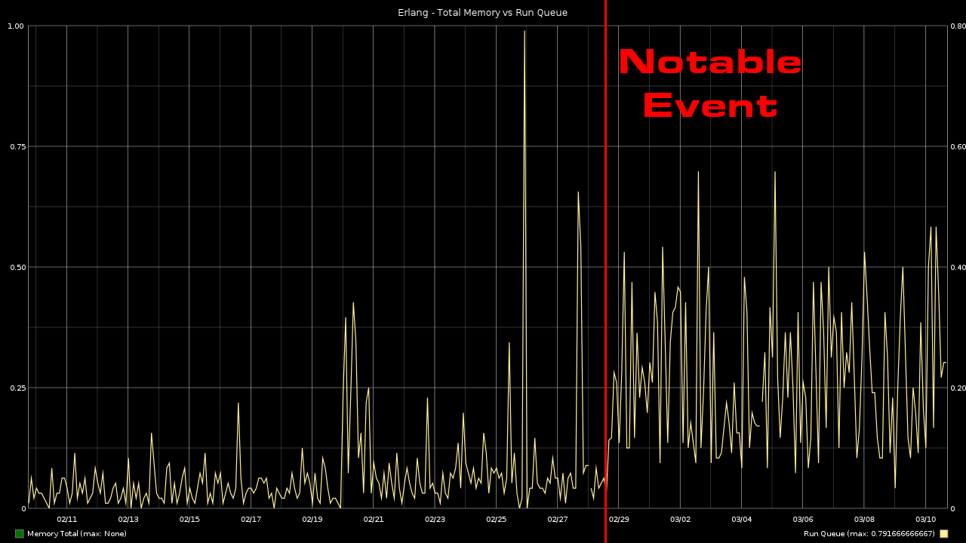

Slide 95
System Monitoring
Diamond: Effective, "pickled" protocol, but big ram footprint (Python).
CollectD: Also effective, very fast, low ram overhead.
Diamond: ~40MB resident, CollectD ~5MB resident.
Various other options out there, graphite being popular.

Slide 96
CollectD Specifics
Avoid installing kitchen sink: collectd-core is probably enough.
Plugin options like "tail" and "exec" offer customization.
"Aggregation" plugin is convenient for many-core systems, etc.

Slide 97
IOwait Example.. Again!
Remember this?
Wrong cause was initially suspected.
Graph drastically narrowed debugging scope.
Huge time-save.
Aggregation simplifies output.

Slide 98
Monitoring Metrics
Deltas and Thresholds can be monitored and alarmed.
Alarms could notify of any trend, even an increase in revenue:

Slide 99
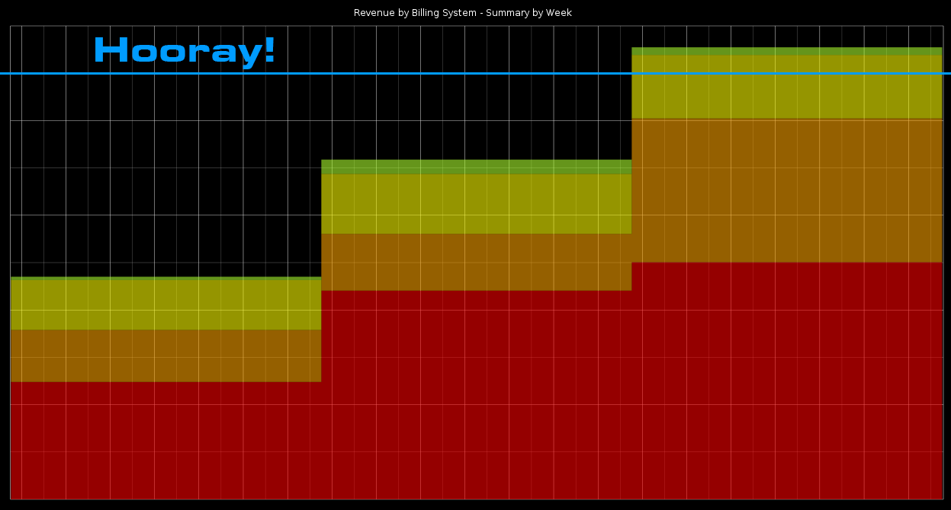

Slide 100
Monitoring / Alarm Solutions
Cabot provides means of triggering by delta, etc.
graphite-beacon: simple python script for alerts by data queries into carbon.
Possible: Skyline (Etsy), AnomalyDetection (Twitter), Anomalizer, modified Monit, etc.
Fire off email, or hit an SMS gateway, etc.

Slide 101
Recording Client Metrics
Graphite can be used end-to-end, receiving any data from clients just as easily (scale challenges apply).
Client performance metrics are useful: Time from App-start to “Fun”. What takes the most time?
Stacked graph of startup, DNS resolution, patch processing, texture loading, etc.

Slide 102
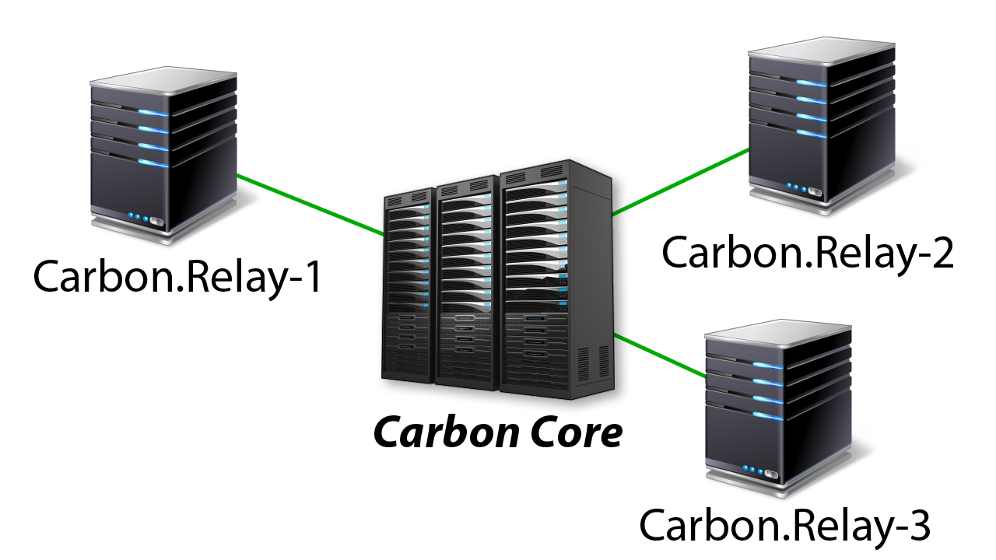
Scaling with Carbon Relay
Aggregates Connections
Buffers to RAM or Disk

Slide 103
Carbon-Relay Alternatives
BackStop: Relays from JSON via HTTP POST to Carbon.
Carbon-c-relay: Compiled C, fast with back-end failover.
Carbon-relay-ng: Compiled C, upwards of a million metrics / second.
And still more..

Slide 104
Log Data Tailing
Syslog-ng, Logster, CollectD all have integrated Graphite/Carbon support.
Tail logs, automatically return metric data that appears.
Add new "metrics" with an additional log-tail/regex.

Slide 105
More Complex Options
MANY ways to do things: Uber vs Etsy vs Instagram, etc.
Statsd solutions can send data to Databases, other than Carbon.
Ganglia, ElasticSearch, other solutions can wire in to augment Graphite, log aggregation, data-diving.

Slide 106
What We Do
"Server/OS" metrics reported independently by CollectD.
"Game" metrics aggregated and reported by Erlang subsystem (“estatsd”).
All fire metrics into carbon-relay for each DC, pickled/aggregated back to core metric server.

Slide 107
Conclusion

Slide 108
Game Server Performance drives scalability and costs.

Slide 109
Automate control of your clusters, at any elastic scale.

Slide 110
Server Update and Revert/Rollback should be simple, foolproof, free of dependency issues.

Slide 111
Measure, Monitor and Alarm Everything!
Awareness of recent history shines a spotlight on problems, saving huge debugging time, and downtime.

Slide 112

Questions?
I will attempt to answer questions, and may just ramble aimlessly.
Contact me, for electronic rambling!
john@guildsoftware.com

